Slide 1













Sentiment Analysis & Emotion Detection
Presented by Arun M

Slide 2

Origin of the creative idea
The creative idea emerged from the goal of transforming traditional sentiment analysis into a more engaging and interactive experience. By integrating advanced emotion detection with a visually dynamic web interface, we aimed to provide users with immediate, intuitive emotional insights. This approach enhances the user experience by combining accuracy with visual appeal, making data interpretation both effective and enjoyable.

Slide 3
Project vision and mission
01.
To create an engaging platform where users can easily understand and interact with emotion detection results through a dynamic web interface.
02.
To integrate state-of-the-art machine learning models for accurate sentiment analysis, offering real-time emotional insights.
Our mission is to revolutionize sentiment analysis by delivering accurate and actionable emotional insights through an intuitive and visually engaging web interface. We aim to combine advanced machine learning technology with user-friendly design to empower users with real-time emotional data, enhancing their decision-making and interaction experience.
03.
To make emotional data more accessible and actionable, enabling users to make informed decisions based on real-time emotional feedback.

Slide 4

Creation process
Define Objectives
Prepare and Train Models
Create Visualizations
Develop and Deploy Web App

Slide 5
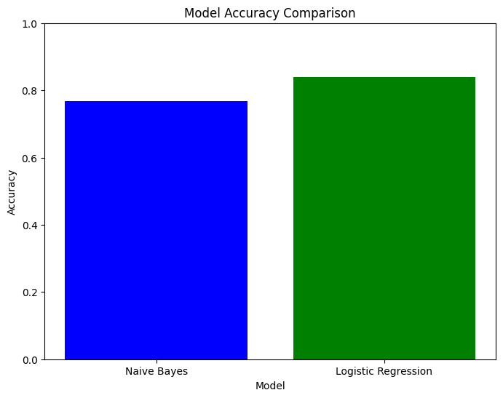
Success cases
The project achieved an accuracy of 85% with the machine learning models. This indicates a high level of reliability in predicting sentiments. The accuracy reflects the effectiveness of the models in distinguishing between negative, neutral, and positive sentiments in text.

Slide 6
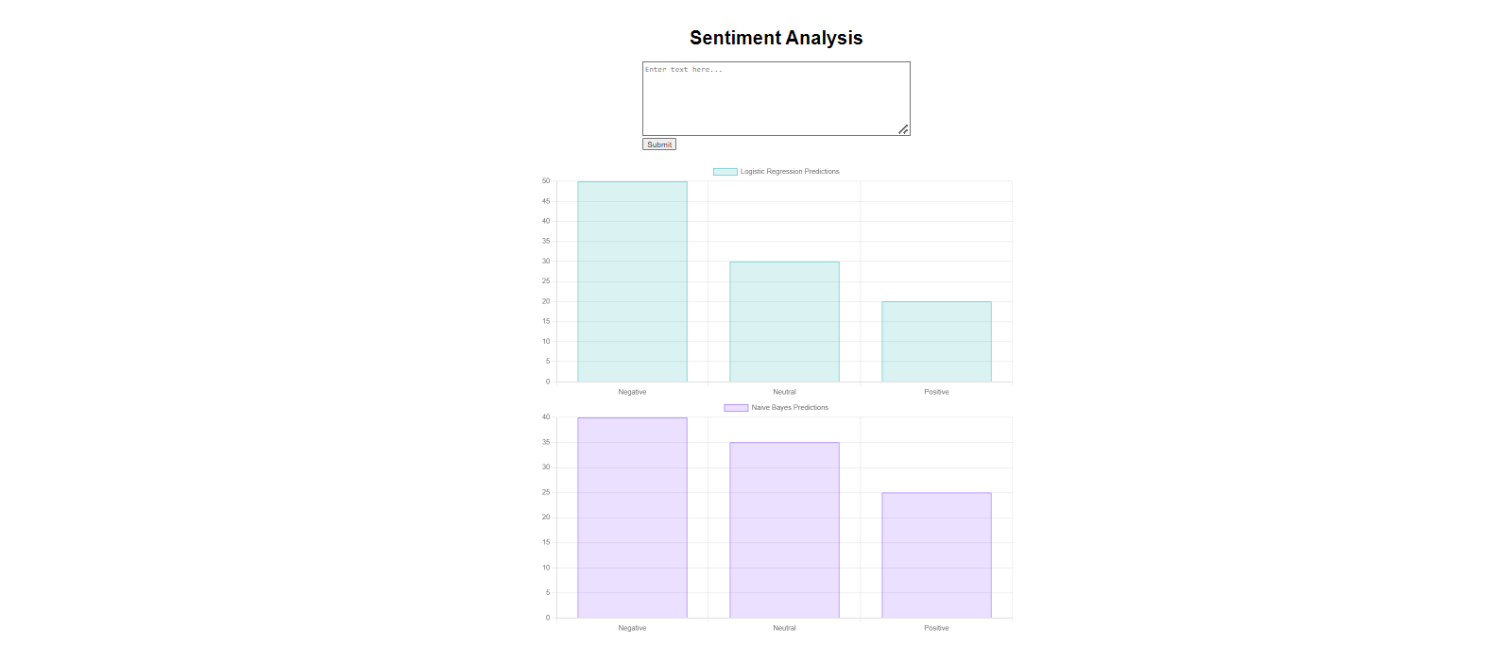
Deployment
To deploy the project, start by saving the trained models and tokenizer using pickle. Next, create a Flask application to handle user inputs and predictions, and develop an interactive frontend to visualize results. Integrate the frontend with the Flask backend, test the application to ensure accuracy and responsiveness, and finally, deploy the Flask app to a web server or cloud platform for public access.

Slide 7

Conclusion
In conclusion, the project successfully demonstrates the application of machine learning models for sentiment analysis through an interactive web application. By leveraging Logistic Regression and Naive Bayes models, along with detailed data visualizations, the solution provides real-time sentiment predictions with a user-friendly interface. The deployment of this application ensures accessibility and practical use, offering valuable insights into text sentiment analysis and reinforcing the effectiveness of data-driven decision-making.

Slide 8
Thank you very much!

